Slide 1

Thunder the Robot
We Teach CS June 06, 2017

Slide 2
Presented by H. Paul Haiduk hhaiduk@wtamu.edu
Computer Science Program Coordinator
School of Engineering, Computer Science and Mathematics
West Texas A&M University
Canyon, TX
(806) 651-2450

Slide 3
Attribution to Richard Pattis
Karel the Robot circa 1981 for the seminal book Karel the Robot.
The word robot comes from the Czech word robota, meaning drudgery or slave-like labor. It was first used to describe fabricated workers in a fictional 1920’s play by Czech author Karel Capek called Rossum’s Universal Robots. According to Pattis, the name Karel the Robot was derived from that early fictional concept and author.
The work as presented today is motivated by the desire to keep alive one of the most profound concepts in computing and one from which literally hundreds of my students have begun their journey into that facet of computational thinking called algorithmic thinking.
Original version of the software written in Pascal and was designed to lead students into the world of Pascal programming. Subsequent versions have been focused on C++ and also Java.

Slide 4
Thunder the Robot
Named so to recognize the mascot for WTAMU . . . a buffalo named Thunder.
Designed to be a “gentle” introduction to the art of algorithmic thinking and programming
Designed to be a gentle introduction to text-based programming with syntax very similar to Python syntax
Written in Java with a “look and feel” designed to be essentially the same in Chrome OS, Linux, Mac and Windows – any platform that supports the Java Virtual Machine
Subsequent work planned to render software completely platform independent by use of JavaScript and HTML 5.

Slide 5
So . . . if you have your computer set up with an Oracle Java runtime . . .
And if you do NOT have the software on your laptop, it is yours for the copying from GitHub. Please use the URL: https://github.com/HHaiduk/thunder
Once downloaded, you should be able to launch its execution by navigating your file explorer to the directory/folder in which you dropped the file thunder-master.zip. You should extract contents of the zip file which normally creates the directory/folder thunder-master. Navigate to that directory/folder and click on the file thunder.jar.

Slide 6
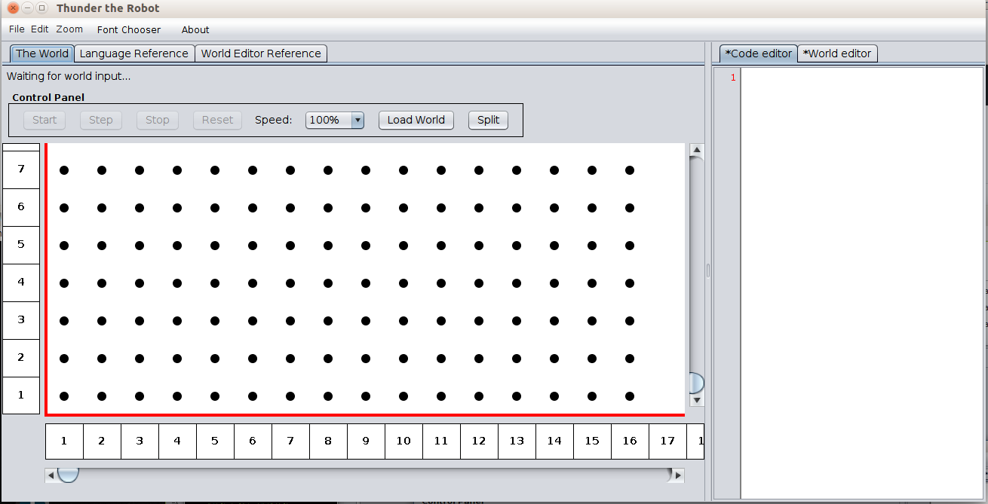

Slide 7
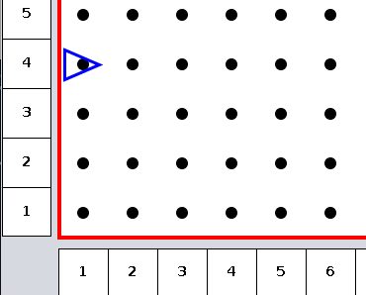
Thunder’s World from the “origin”
Dots represent intersection of streets and avenues
The triangle is the robot located at first avenue and fourth street
Think of north/south orientation as the Avenues while the streets are east/west
The robot (yes . . . Intentionally very simple representation) is facing east.
This world is finite with 1,000 avenues and 1,000 streets
Think x = avenue and y = street

Slide 8
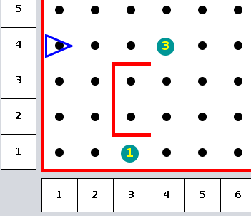
Thunder’s World (more)
World is bordered with impenetrable walls
We may build more walls in the world to pose challenges to the robot’s travel – these walls are placed between streets and/or avenues. Also note that these interior walls are also impenetrable
We may place beepers (little devices that emit a sound) at intersections. Note that the robot must be immediately over the beeper to “hear” its sound.

Slide 9
Thunder’s builtin capabilities
move -- exactly one block in direction Thunder is facing– this can cause Thunder to break apart if it strikes a wall
turnleft -- rotate left exactly 90º -- Thunder can always accomplish this no matter where it is located
pickbeeper – pick up one beeper and place it in a “virtual” beeper bag – this may cause a runtime failure if there is no beeper to pick up
putbeeper – retrieve a beeper from the “virtual” beeper bag and place it at the current intersection – this may cause a runtime failure if there is no beeper in the beeper bag
turnoff – this instruction must be executed when Thunder has completed any given task
Consider these the primitives of the language supporting the robot

Slide 10
Thunder’s sensors
front_is_clear
front_is_blocked
left_is_clear
left_is_blocked
right_is_clear
right_is_blocked
Wall detection tests

Slide 11
Thunder’s sensors
next_to_a_beeper
not_next_to_a_beeper
any_beepers_in_beeper_bag
no_beepers_in_beeper_bag
Beeper detection tests

Slide 12
Thunder’s sensors
facing_north
not_facing_north
facing_south
not_facing_south
facing_east
not_facing_east
facing_west
not_facing_west
Direction detection tests

Slide 14
Simple Thunder world
First we must create the world in which Thunder will operate.
Click on the World Builder tab in the application and enter/edit the text to appear as: ROBOT 1 1 E 0
This directs the application to “draw” Thunder at 1st Avenue and 1st Street, facing East, with 0 beepers in the beeper bag.
Next, click the Load World button in the Control Panel to cause that initial scenario to be displayed. Please note positioning Thunder in the world is the only manual coding required for the world builder. Creation of walls and beepers can all be accomplished with a mouse in real time.

Slide 15
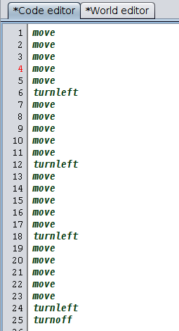
Simple Thunder program
Traverse a path that is five by five and turn off.
To avoid typing this in, first Split the editor pane away from the application pane and click File/Open Source File and navigate to the directory/folder where thunder.jar exists and load program01.thunder
One could also File/Open World File and load program01.world.
One can than launch the program by clicking Start in the Control Panel or single-step through the program with Step.

Slide 16
Control Structures
Each Thunder the Robot instruction must be on a separate line. A sequence of one or more Thunder the Robot instructions that are all indented the same number of spaces compose a block of code.
<instruction> refers to any of the five primitive instructions, conditional branching or iteration instructions, or a user defined instruction.
Thus, a block appears as: <instruction> <instruction> ... <instruction>
Sequence or “block”

Slide 17
Control Structures
Conditional branching refers to the ability of a program to alter it's flow of execution based on the result of the evaluation of a conditional. The three types of conditional branching instructions in Thunder the Robot are if and if/else and if/elif/else. In the below examples, <test> refers to one of the eighteen conditionals or sensor tests presented previously. Each <test> evaluation results in true or false.
if <test>: <block>
if <test>: <block> else: <block>
Conditional or selection
NOTE that the controlled blocks are “opened” by placing a colon ( : ) immediately after the <test>
We say that the colon “opens” a scope of control. Yes, this is very Python like (by design)
if <test>:
<block>
elif <test>:
<block>
...
elif <test>:
<block>
else:
<block>

Slide 18
Control Structures
Iteration refers to the ability of a program to repeat an instruction (or block of instructions) repeatedly. The two types of iteration instructions are the definite and indefinite.
Definite iteration is supported by the do <pos_number> where <pos_number> must be an unsigned integer greater than zero.
do <pos_number>:
<block>
Indefinite iteration means that the number of iterations can vary from none to many with termination controlled by some <test>.
while <test>:
<block>
NOTE: that the do repetition is the only place in the Thunder the Robot language where counting is possible.
Iteration repetition looping
Again note the colon ( : ) “opens” the scope of control

Slide 19
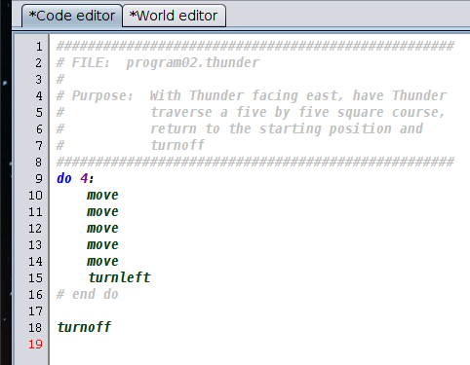
Using definite repetition
And adding comments to enhance readability
See program02.thunder
Comments? The symbol # begins a comment with the remainder of the line considered the comment. They are ignored by the interpreter.

Slide 20
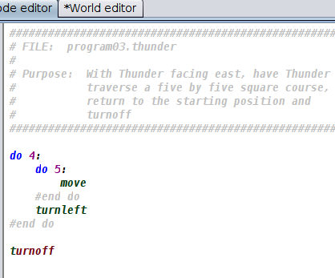
And refining a bit more
See program03.thunder

Slide 21
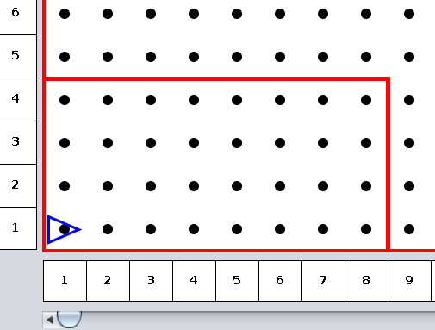
Using indefinite iteration
Yes, if we knew that the boundaries were fixed and would remain the same, we could solve this similarly to the five by five.
However, we want Thunder to navigate any rectangular enclosure and return to starting point.

Slide 22
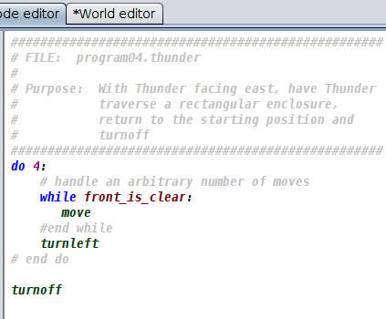
Using indefinite iteration
We have a problem similar to the previous one EXCEPT that we now have constraints (walls) that we cannot penetrate AND we do not know in advance how big the enclosure is.
Note, however, this is a problem similar to the previous problem.
See program04.thunder

Slide 23
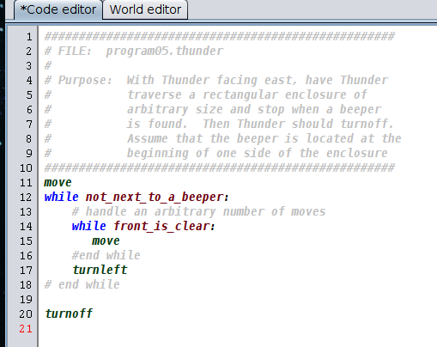
Using indefinite iteration
Now lets change the problem up just a bit. We want Thunder to walk around the enclosure until a beeper is found. Then Thunder is to turnoff. Assume that the beeper is at the beginning of one of the sides of the enclosure.
See program05.thunder and program05.world

Slide 24
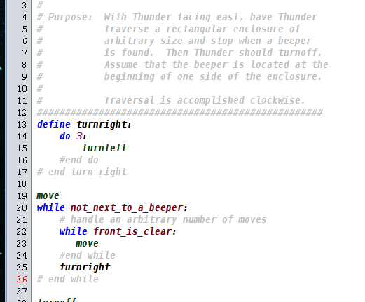
Introducing procedural abstraction
Now lets change the problem up just a bit. We want Thunder to walk around the enclosure until a beeper is found. Then Thunder is to turnoff. Assume that the beeper is at the beginning of one of the sides of the enclosure. However, instead of completing the course counter clockwise, we want to navigate the course clockwise.
See program06.thunder and program06.world

Slide 25
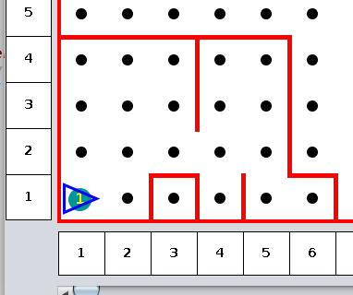
A challenging problem
Navigate an enclosure that has irregular shape.
See program07.world
Issues:
Cannot collide with a beeper
Must navigate around walls that fall away from us
Strategy:
How do we follow the wall?
One strategy is to always follow the wall to the right

Slide 26
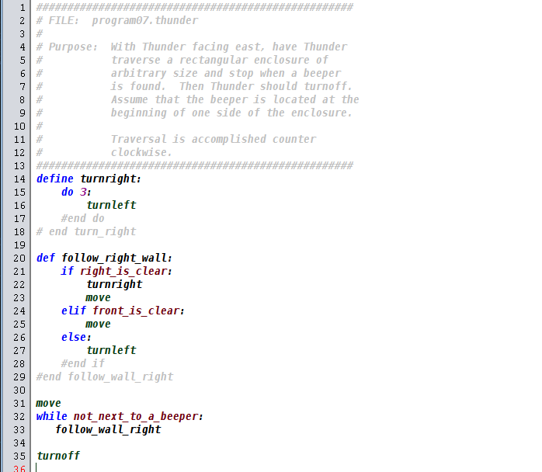
Follow wall to the right
See program07.thunder

Slide 27
Follow_right_wall good for navigating a maze
Assume that there are NO islands in the maze
Assume that we place a beeper to the right of the single exit from the maze
Assume that we position Thunder so that it is at the entrance
See followWall.thunder and followWall.world
See also mazeBig.world

Slide 28
How about cleaning trash from an enclosed park?
An enclosed “park” of arbitrary length and arbitrary width ( avenues and streets) contains scattered piles of beepers. It is Thunder’s responsibility to start in the southwest corner of the park facing east and sweep by street and clean up all the piles of beepers.
Once all the beepers are cleaned up, they are to be deposited in the northeast corner of the park.
Then Thunder is to return to the southwest corner, face east and turn off.
See cleanTrash.thunder and trash1.world and trash2.world

Slide 29
How about “sorting” into ascending order the heights of columns of beepers
See Sort.thunder and Sort.world
Givens:
“stacks” of beepers of arbitrary height from zero to many
“stacks” are represented by a single beeper at an intersection
Arbitrary number of “stacks”
“stacks” are bounded on east and west by a wall that is at minimum at least one unit higher than the height of the tallest “stack” of beepers
“stacks” of beepers are guaranteed to exist in a situation in which there is an empty “stack” on the west and the east of the “stacks” to be considered
Thunder is to start the sort by facing east at 1st Avenue and 1st Street and is to return to the “home” position at 1st Avenue and 1st Street.
Solution developed that the “main” logic is to drive what happens including turning off.

Slide 30
Iteration vs. Recursion
Iteration
Recursion
def face_east: while not_facing_east: turnleft #end while # end face_east
def face_east: if not_facing_east: turnleft face_east #end if # end face_east

Slide 31
Questions, observations, etc.

Slide 32
The End

